Slide 1
Anatomy of the Case

Slide 2
Warriors Case
Case Background
About the Warriors
The Data Science Team
The Ticketing Model
The Data
Which to use and why

Slide 3
Data Science Process
Development
EDA
Model Building
Evaluation
Adoption
Tip-Off

Slide 4
AI capability Maturity Model – How do I begin?
Jason Williamson Professor of Practice,
University of Virginia School of Data Science

Slide 5
The Promise of AI is Endless
Market Growth and Investment:
The global AI market size is expected to reach USD 1,597.1 billion by 2030, growing at a compound annual growth rate (CAGR) of 38.1% from 2022 to 2030 (Grand View Research, 2021).
AI startup funding reached over $93 billion in 2021, with more than 9,100 deals globally (CB Insights, 2021).
Adoption Across Industries:
In healthcare, AI applications are projected to potentially create $150 billion in annual savings for the US healthcare economy by 2026 (Accenture, 2021).
In the manufacturing sector, 63% of companies have adopted AI for product innovation and R&D (Deloitte, 2020).
The adoption of AI in the finance sector is expected to save banks $447 billion by 2023 (Business Insider, 2021).

Slide 6
AI sounds Awesome, but I’m not sure where to start
Why is it hard to start?
Cultural blockers
Data Quality and Availability
Lack of AI Talent
Ethical and Regulatory Considerations

Slide 7
Enter the AI Capability Maturity Model
A little history
First Introduce in the late 1980’s by CMU from work done by IBM
Tool for US Government Contractors to develop software
It’s been adapted and adopted over the years for other disciplines
It contains stages and attributes of each stage – so you know where you are and where you are going

Slide 8
AI-CMM
Enhancement
Adoption
Research
Iteration/Struggle
Experimentation

Slide 9
Research Stage
Characteristics
Understand AI capabilities. Do you even know what is out there?
What are the applications in your space? What you your use cases?
What are the data requirements?
Assessment of what you have inhouse and what you need. Do you even have the data?

Slide 10
Experimentation Stage
Characteristics
Small scale projects are launched.
Study of feasibility and impact based on pilot projects.
Learnings include human resource needs to scale.
You are building a framework for testing/learning/scaling
You have a robust data management process in place

Slide 11
Iteration and Struggle
Characteristics
As you scale you see the holes in your model – life in the wild.
Prediction of impact not always what you thought.
It’s hard to get people on board and trained up.
You will conduct retrospectives to refine how you scale and apply the results.
You begin to develop more sophisticated models.

Slide 12
Adoption
Characteristics
As the technology is proven, you begin to traverse the organization
Trust is being built in the org by the humans
Establish integration model with your data management platforms
Scaling new data sources is easier and welcomed
AI is the fabric of the company operations

Slide 13
Enhancement
Characteristics
AI is deeply embedded in most processes, HR, Ops, Sales, Support
Focus is now on sustaining the growth and the ethical impact of AI
You begin to push the boundaries on the next stages and projects
AI is a full citizen within both IT and the business and results are measured along side human productivity and levers on the balance sheet.

Slide 15
A/B Test: Definition and Design
- Parallel Comparison: Population split into groups (A, B, etc.).
- One-time Exposure: Each group exposed to only one treatment.
- Between-Subjects Design: Outcomes compared between different subjects.
- Example: Testing two website layouts.

Slide 16
Switchback Experiment: Definition and Design
- Sequential Comparison: Same subjects exposed to different treatments over time.
- Repeated Measures: Outcomes measured after each treatment phase.
- Within-Subjects Design: Comparison of outcomes within the same subjects.
- Example: Comparing two diets on the same group over different time periods.

Slide 17
Purpose and Applications
- A/B Test:
* Used for broad comparisons across a population.
* Common in digital marketing, web design, and UX testing.
- Switchback Experiment:
* Used for time-dependent comparisons within the same subjects.
* Common in agriculture, healthcare, and economics.

Slide 18
Advantages of Each Method
- A/B Test:
* Simplicity and ease of setup.
* Randomization helps eliminate biases.
- Switchback Experiment:
* Controls for individual differences.
* Ideal for reversible effects.

Slide 19
Limitations of Each Method
- A/B Test:
* Susceptible to between-group variability.
* Limited to one-time exposure.
- Switchback Experiment:
* More complex to design and analyze.
* Time-consuming with potential carryover effects.

Slide 20
Summary of Differences
- A/B Test:
* Best for straightforward, between-subject comparisons.
- Switchback Experiment:
* Ideal for within-subject comparisons over time.

Slide 21
Conclusion
- Choosing the right method depends on the research question and context.
- A/B Tests for broad comparisons, Switchback Experiments for time-sensitive, within-subject analysis.

Slide 22
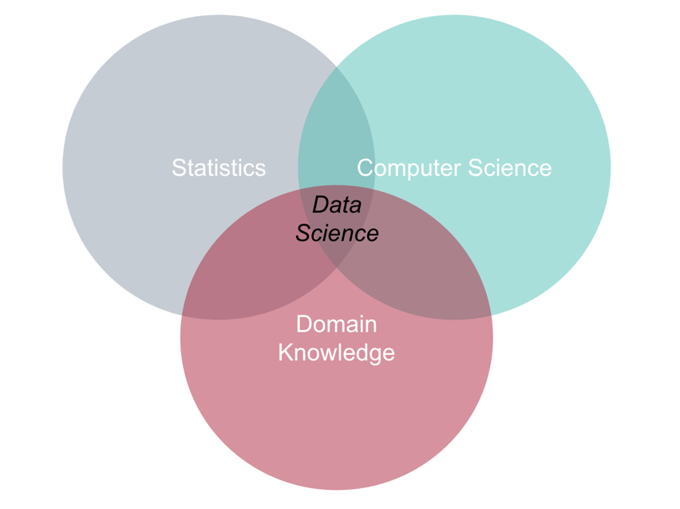
TN Figure 1: Definition of Data Science
Source: Casewriter.

Slide 23
TN Table 1: Case data variable names and description
Variable Name | Description
customerID | A unique ID representing the customer who made the purchase.
customerName | The name of the customer who made the purchase.
Age | The age of the customer at the time of the purchase.
Fan_Mailing_List | A binary variable indicating whether the customer was on the fan mailing list (Yes or No).
Customer_Type | The customer type (Planner, In-Between, or Last-Minute). These customer segments were developed by a marketing consultancy based on a small subset of customers who were interviewed.
Game_ID | A unique ID representing the game the tickets were purchased for.
Num_Tickets_Purchased | The number of tickets purchased in the transaction.
Seat_Location | The location of the seats purchased (Upper or Lower).
Ticket_Price | The price of the ticket in U.S. dollars (or the average ticket price if multiple tickets were purchased).
Concession_Purchases | Amount spent by the ticket purchaser on concessions during the game.
Days_Before_Game | The number of days between the date the ticket was purchased and the date of the game.
Source: Casewriter.

Slide 24
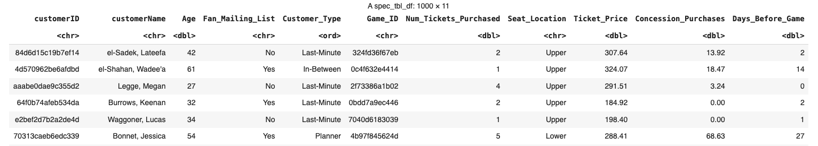
TN Figure 2: First six rows of the data
Source: Casewriter.

Slide 25
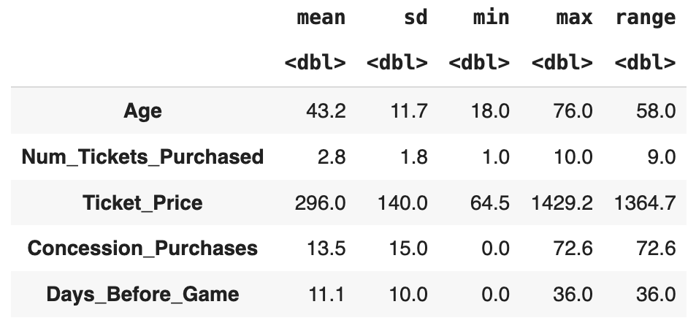
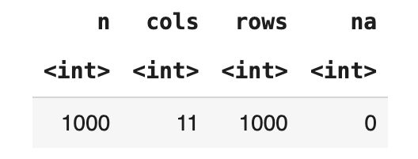
TN Figure 3: Summary statistics of the numeric variables in the data
TN Figure 4: Basic summary of the data
Source: Casewriter.
Source: Casewriter.

Slide 26
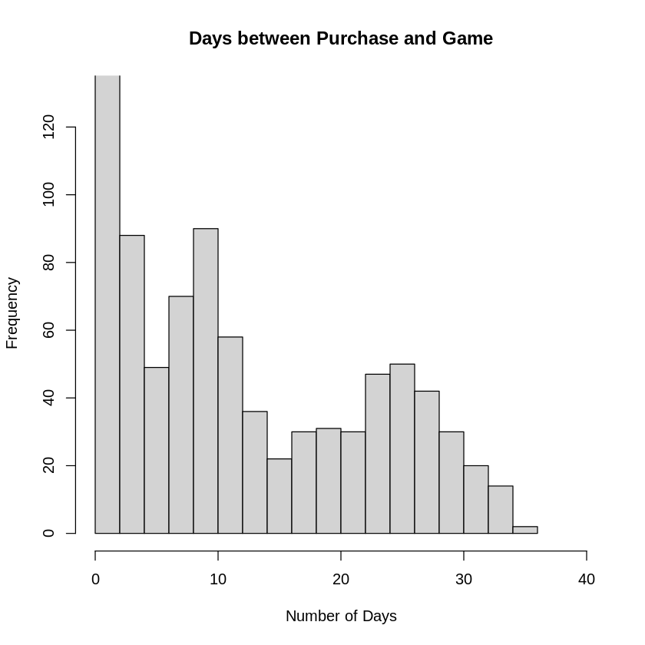
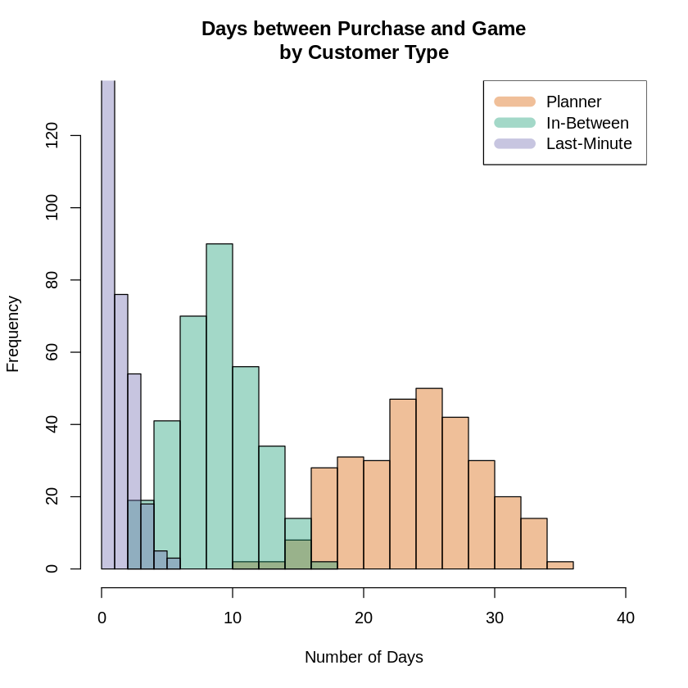
TN Figure 5: Histogram of Days_Before_Game
TN Figure 6: Histogram of Days_Before_Game grouped by Customer_Type
Source: Casewriter.
Source: Casewriter.

Slide 27
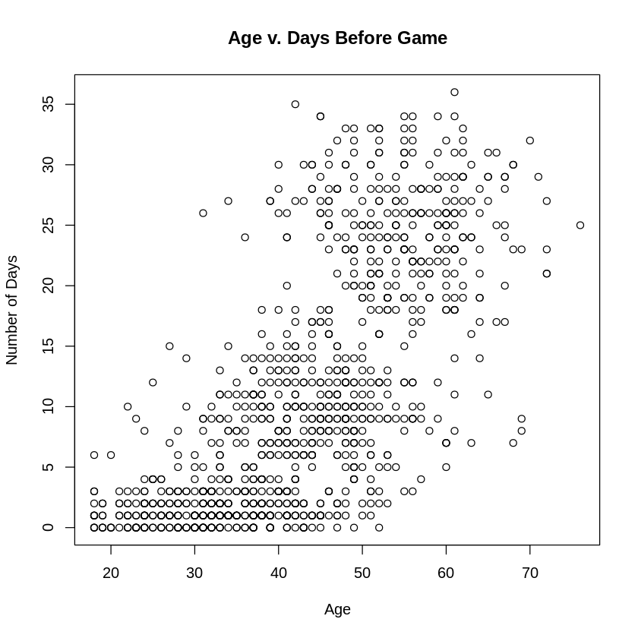
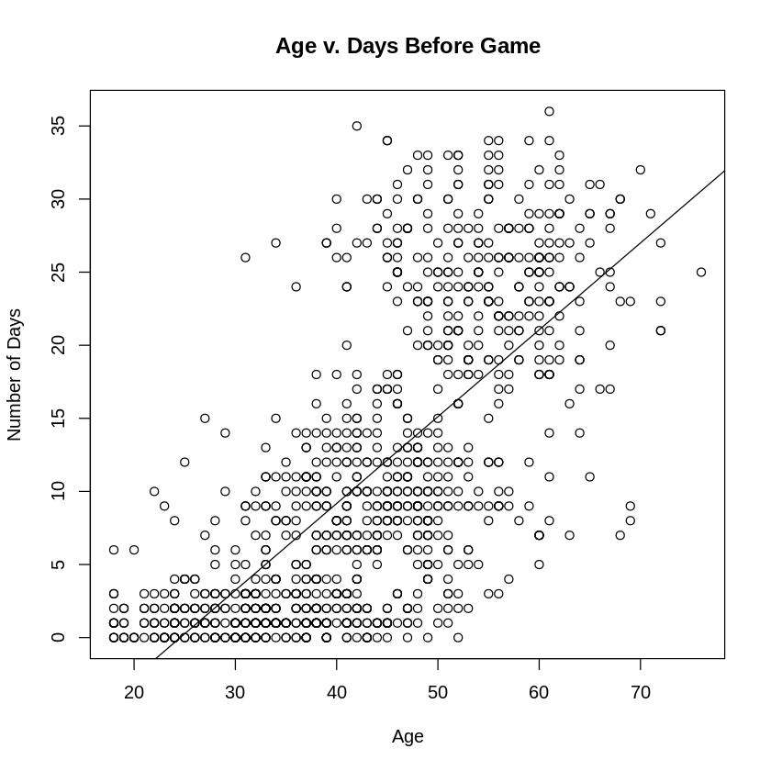
TN Figure 7: Scatterplot of the relationship between Age and Days_Before_Game
TN Figure 10: Scatterplot of the relationship between Age and Days_Before_Game with the line of best fit
Source: Casewriter.
Source: Casewriter.

Slide 28
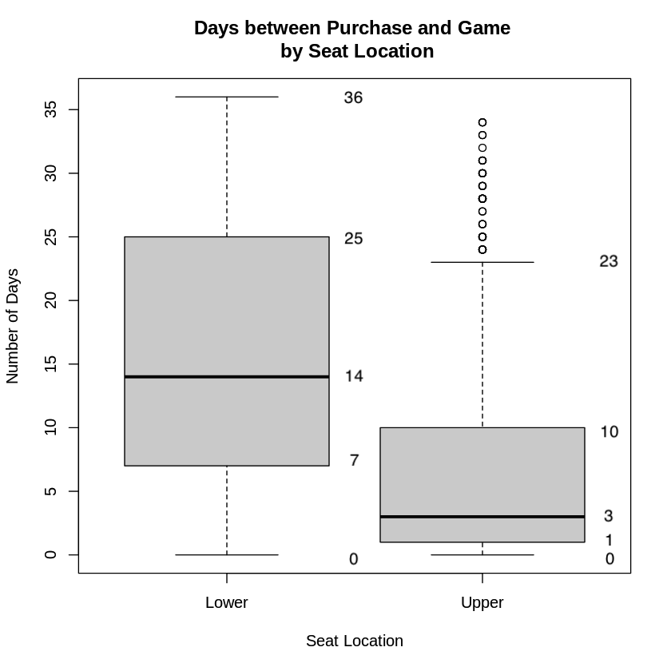
TN Figure 8: Boxplot of the relationships between Days_Before_Game and Seat_Location
Source: Casewriter.

Slide 29
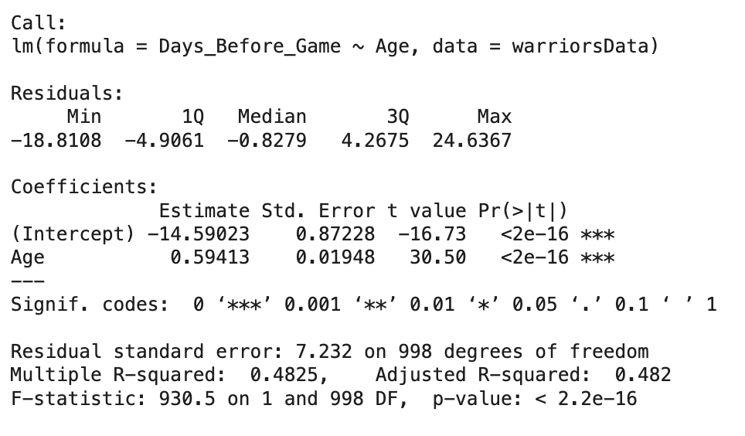
TN Figure 9: Simple linear regression model prediction Days_Before_Game
Source: Casewriter.

Slide 30
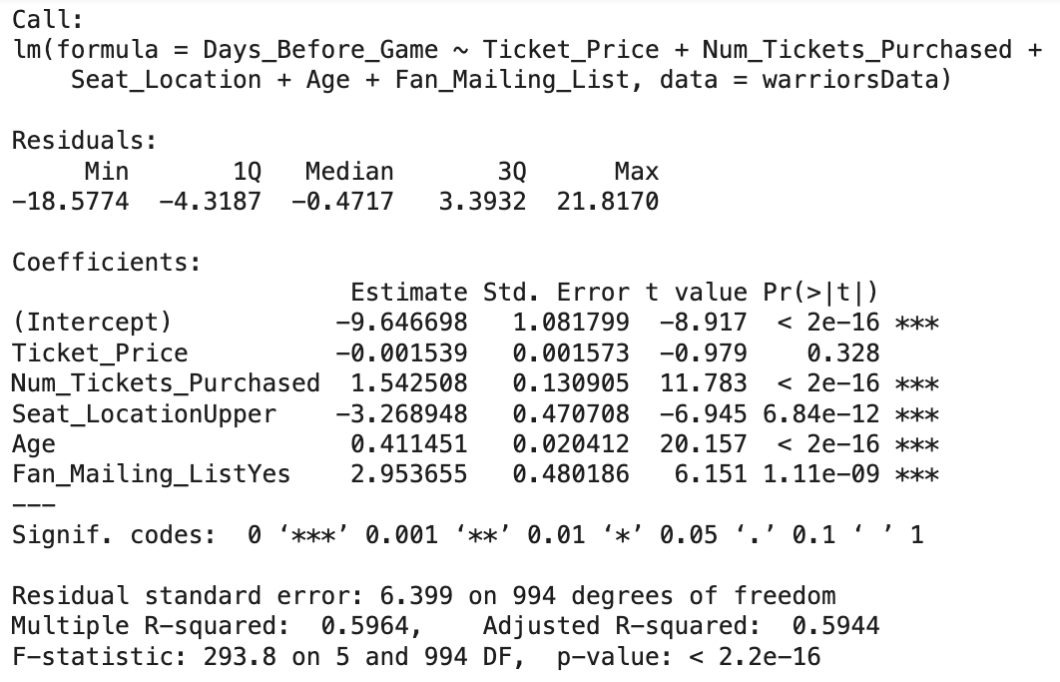
TN Figure 11: Multiple Linear Regression predicting Days_Before_Game
Source: Casewriter.

Slide 31
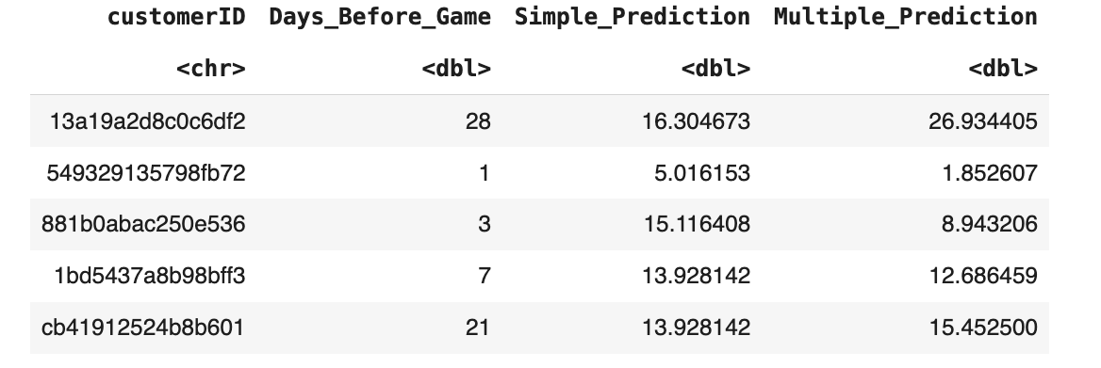
TN Figure 12: Table of five new observations with actual Days_Before_Game and predicted values from the simple and multiple linear regression models
Source: Casewriter.

Slide 32
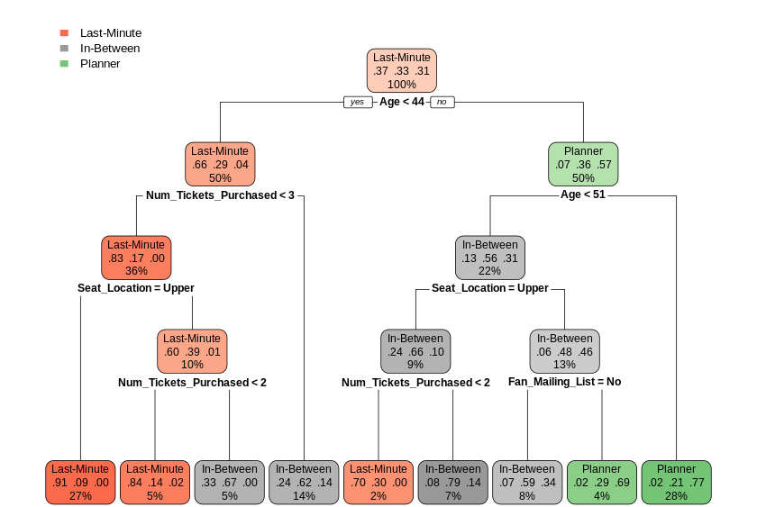
TN Figure 13: Decision tree predicting Customer_Type. The text at the top of each node represents that majority class; the three numbers represent the proportion of customers that fall into the Last-Minute, In-Between, and Planner types, respectfully; and the percentage is the percentage of the data in the node.
Source: Casewriter.

Slide 33
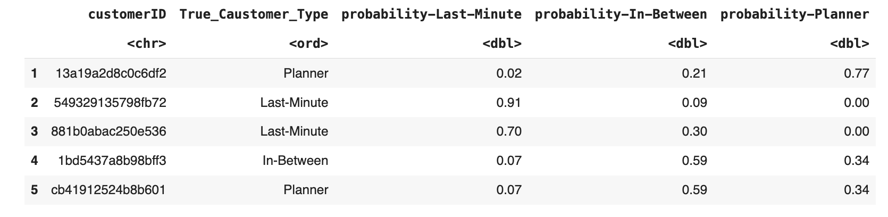
TN Figure 14: Table of five new observations with actual Customer_Type and predicted values from the decision tree model
Source: Casewriter.

Slide 34
TN Table 2: Why did the Warriors create a Data Science Team?
Internal | External
Growing Volume of Company Data: As businesses digitize their operations, they generate a growing volume of data. Without data science capabilities, this wealth of data remains untapped. (line 31 page 3) Desire to Become Data-Driven: Many organizations recognize that decisions guided by data are more accurate and effective than those based on intuition alone. By developing data science capabilities, organizations can use predictive modeling and other techniques to guide decision-making and strategy. (line 15 page 2) Cost Reduction and Profitability: Data science can identify inefficiencies in processes, predict maintenance needs to prevent costly equipment failures, and help optimize resource allocation—all of which can lead to significant cost savings. (line 17 page 3) Digital Transformation: As part of broader digital transformation efforts, data science plays a key role in automating processes, enhancing customer experience, and creating new digital products or services. (line 19 page 2) | Competitive Landscape: As more companies build their data science capabilities and begin to leverage the benefits, there is pressure on others to keep up. Failing to invest in data science capabilities could lead to a competitive disadvantage. Demonstrated Value of Data Science: Success stories of other companies using data science to drive growth and profitability can put pressure on organizations to develop similar capabilities. This is especially true in industries where data science has already disrupted traditional business models. (line 28 page 2) Customer Expectations: In an era where personalized experiences are becoming the norm, data science is crucial in delivering customized products, services, and interactions, meeting ever-evolving customer expectations.
Source: Casewriter.

Slide 35
TN Table 3: Team Structure
Embedded Data Science Team | Centralized Data Science Team
Deep Business Understanding: Data scientists can better understand business needs by being close to the business units. Fast and Focused Solutions: Embedded data scientists can provide quick, focused solutions tailored to the unit's needs. Ease of Communication: Data scientists have easy and direct access to decision-makers and operators within the unit, which can streamline communication and ease adoption of data science products. | Cross-Functional Perspective: A centralized team has a broader, organization-wide perspective, which can lead to more comprehensive and generalizable insights. Efficient Resource Use: Centralized teams can effectively manage resources and avoid duplication of efforts, as they can see and manage all data science projects across the organization. Standardized Practices: A centralized team can implement consistent tools, methodologies, and standards across all projects, improving quality and efficiency.
Source: Casewriter.

Slide 36
TN Table 4: Quick wins benefits and weaknesses
Pros | Cons
Demonstrate Value: Quick wins can provide tangible results that demonstrate the value of data science to stakeholders, which can be particularly useful in securing further support and resources. Builds Momentum: Successful projects elevate team morale and frequently gain recognition across various departments within a business. Positive attention and feedback increase opportunities for collaboration and foster a proactive culture around data science. Optimizes Resources: Often requires fewer resources and can be a cost-effective way to achieve results. Learning Opportunities: This can provide valuable insights and lessons that can be applied to larger projects and can help the team familiarize themselves with the organization's data and business context, allowing them to develop valuable knowledge and experience to inform the process they might use with larger projects. | Short-term Strategy: Often there are tensions between short-term victories and long-term strategies. Investing in complex initiatives that align strategically with the core mission of the business contributes to the longevity and impact of the team. Potential for Misalignment: Quick wins that are not aligned with the organization's broader goals or vision can lead to fragmented efforts and confusion. Skewed Expectations: Achieving quick wins could set unrealistic expectations among stakeholders about the speed and ease of future data science projects. Limited Nature: There is a limited number of high-impact quick wins. Resource Allocation: Focusing on quick wins might divert resources from building foundational elements like data infrastructure, governance frameworks, and talent development, which are necessary for long-term success.
Source: Casewriter.

Slide 37
TN Table 5: The purpose of exploratory data analysis
Why start with EDA
Understanding the Data: Before any modeling or complex analyses, it is essential to comprehend the nature of the data at hand. Identifying Patterns and Relationships: Through visualization and basic statistics, EDA can help uncover patterns, relationships, and correlations between variables in the dataset. Data Cleaning: EDA is used to identify missing values, outliers, or other anomalies in the data that need to be addressed before further analysis. Feature Engineering: By understanding the distribution and relationships within the data, one can derive new features that might be beneficial for modeling. EDA is a valuable guide in this regard. Model Choice: The type and distribution of the data can inform the choice of models or algorithms to apply. For example, if a dataset has a linear relationship, linear regression might be a good choice. Assumptions Checking: Check statistical assumptions. Stakeholder Communication: Graphical representations and summaries derived from EDA can be valuable when explaining findings to stakeholders or team members who might need a deeper understanding of the data or the technical nuances of the project. Guiding Further Questions: EDA often leads to hypothesis generation. Building Intuition: Spending time with the data builds an intuition about it. This intuition can be invaluable as the project progresses, allowing data scientists to make informed decisions quickly.
Source: Casewriter.

Slide 38
TN Table 6: Pros and cons of prediction models
 | Linear Model Days_Before_Game | Decision Tree Customer_Type
Strengths | Detailed: Analysis is more granular. Data Availability: The outcome variable is defined for all past purchases. Cost: Low cost as the model is typically fast to train. Interpretability: Provide coefficients that indicate the strength and type of relationship between each predictor and the target variable, making the results interpretable. | Actionable: Results can be directly used by the marketing team. Predictability: Easier to make predictions on groups. Non-linearity: Can model nonlinear relationships effectively and can handle complex interactions between different predictors. Interpretability: Easy to understand and interpret as they mimic human decision-making more closely than regression models.
Weaknesses | Nonlinearity: Assumes a linear relationship between predictors and the target variable, which is often not the case in real-life scenarios. Deployment: May be too granular and hard to convert into actionable tasks. | Less Data: Only have data on 1000 individuals that are interviewed. These may not be representative of the broader customer population.
Model Use | Extreme Personalization: Email each fan at the most optimal time. | Simple Personalization: Email sent to three customer groups at their respective optimal times.
Source: Casewriter.

Slide 39
TN Table 7: Experiment vs. Launch
Experiment | Launch
Risk Mitigation: Experimentation helps identify and address potential problems before a full-scale launch, reducing risk. Data-Driven Decisions: Testing allows for data-driven decisions, improving the chances of product success. Switchbacks allow for direct causal measurement. Customer Insights: Experimentation can provide insights into customer preferences in a more controlled setting. It controls for other factors such as poor team performance. Refined Product: The product or service can be refined and improved based on test results, leading to a higher quality offering. | Speed to Market: Quickly launching allows a company to capture market share, potentially outpacing competitors. Lower Opportunity Cost: Immediate launch can lead to faster revenue generation and lower opportunity cost if the model works. Infrastructure: No need for additional experimentation infrastructure. Lack of Statistical Power: The experiment may not have enough power to detect an effect, meaning that it unnecessarily slows down the launch.
Source: Casewriter.

